Slide 1
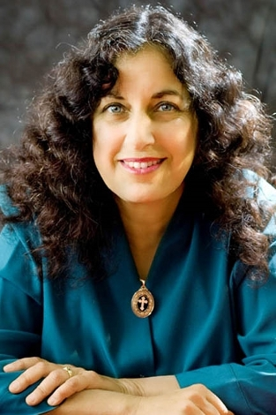
Americas Award Workshop with Margarita Engle A professional development workshop for Educators
February 27, 2018
4:30 – 7:30 p.m.
Stanford University
Notes:
Introductions
Molly
Elizabeth
Francisco Jimenez (full bio later)
Teachers

Slide 2
Americas Award

Slide 3
Purpose of the Americas Award
Encourage and commend authors, illustrators and publishers who produce quality children's and young adult books that portray Latin America, the Caribbean, or Latinos.
Provide teachers with recommendations for classroom use, the national Consortium of Latin American Studies Programs (CLASP) offers up to two annual book awards, together with a commended list of titles.
http://claspprograms.org/americasaward
Notes:
Jorge Argueta won the Americas Award for A Movie in my Pillow / Una película en mi almohada , his first collection of poems for children, in 2001 (the same year as Breaking Through by Francisco Jimenez)
Xochitl and the Flowers on the commended list for 2003 Arroz con Leche / Rice Pudding: Un poema para cocinar / A Cooking Poem on the commended list for 2011
Salsa: Un poema para cocinar / A Cooking Poem on the commended list for 2016 Somos como las nubes / We are Like the Clouds on the commended list for 2017

Slide 4
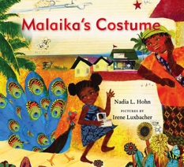
Recent winners
2017 AWARD WINNERS
Ada’s Violin written by Susan Hood and illustrated by Sally Wern Comport. Simon & Schuster Books for Young Readers, 2016.
The Only Road written by Alexandra Diaz. Simon & Schuster, 2016.
2017 HONORABLE MENTIONS
Malaika’s Costume written by Nadia L. Hohn and illustrated by Irene Luxbacher. Groundwood Books, 2016.
The Distance Between Us written by Reyna Grande. Aladdin, Simon & Schuster, 2016.
http://claspprograms.org/americasaward
Notes:
Plus 13 Commended Titles, including Jorge Argueta’s Somos como las nubes / We Are Like the Clouds and Duncan Tonatiuh’s The Princess and The Warrior

Slide 5
The Américas Award is sponsored by CLASP and coordinated by the Stone Center for Latin American Studies at Tulane University. Additional funding is provided by Florida International University, Stanford University, The Ohio State University, University of New Mexico, University of Utah, University of Wisconsin, Milwaukee, and Vanderbilt University.
Today’s Américas Award Workshop at Stanford University is made possible by the Center for Latin American Studies (CLAS) and funding from the U.S. Department of Education Title VI National Resource Center Grant.
http://claspprograms.org/americasaward

Slide 6
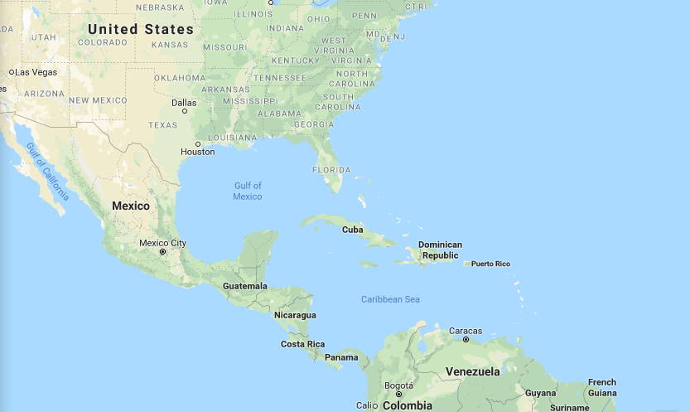
Cuba
Source: Google Maps
Notes:
Bio

Slide 7
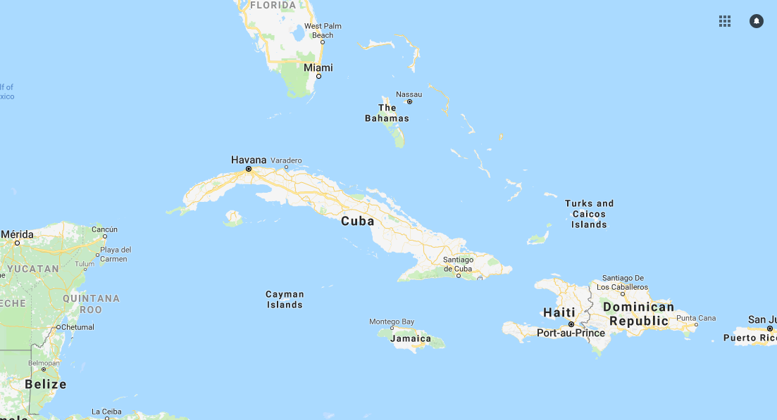
Cuba
Source: Google Maps
Notes:
Bio

Slide 8
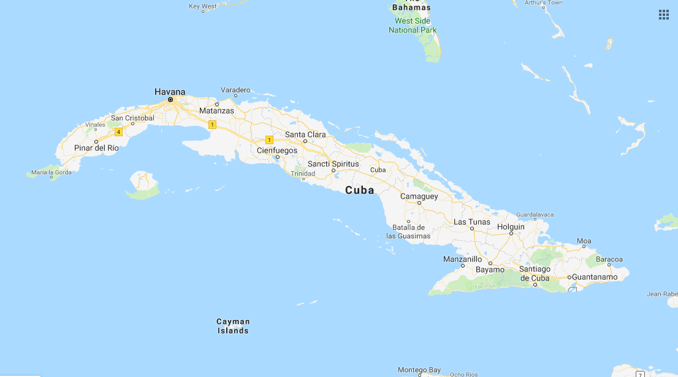
Cuba
Source: Google Maps
Notes:
Bio

Slide 9
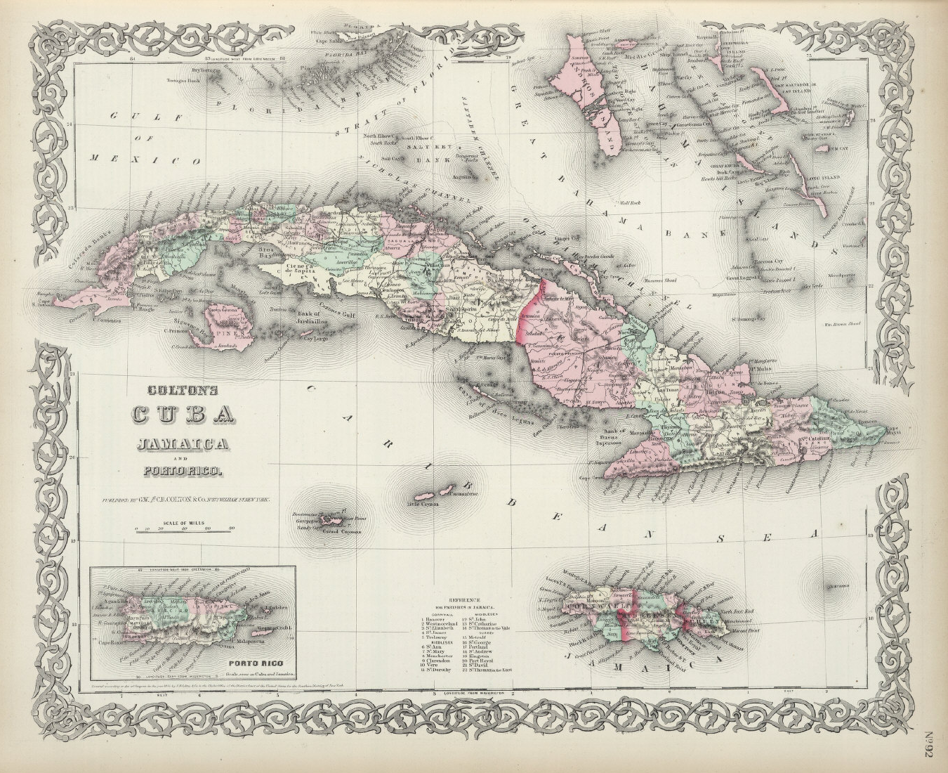
Cuba
Source: Dave Rumsey Map Collection -- Map Date: 1874
Notes:
Bio

Slide 10
Panama
Source: Google Maps
Notes:
Bio

Slide 11
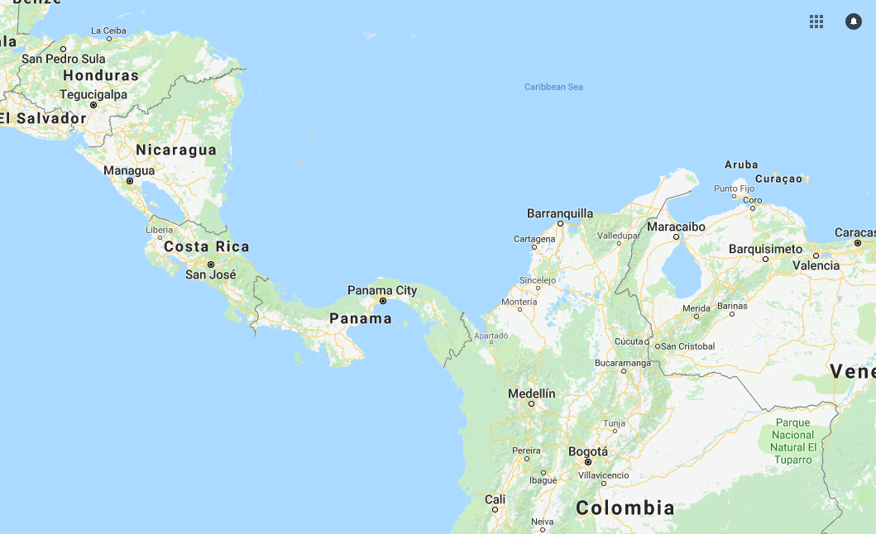
Panama
Source: Google Maps
Notes:
Bio

Slide 12
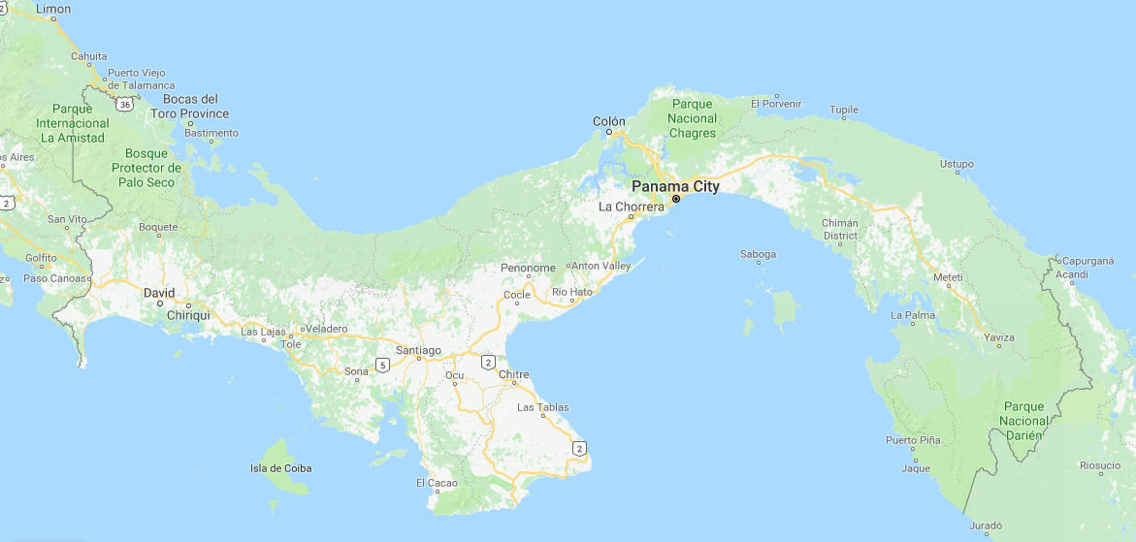
Panama
Source: Google Maps
Notes:
Bio

Slide 13
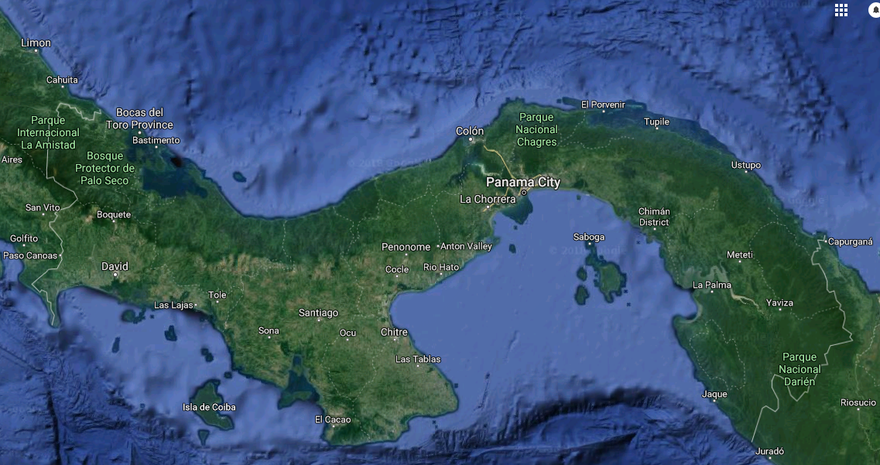
Panama
Notes:
Bio

Slide 14
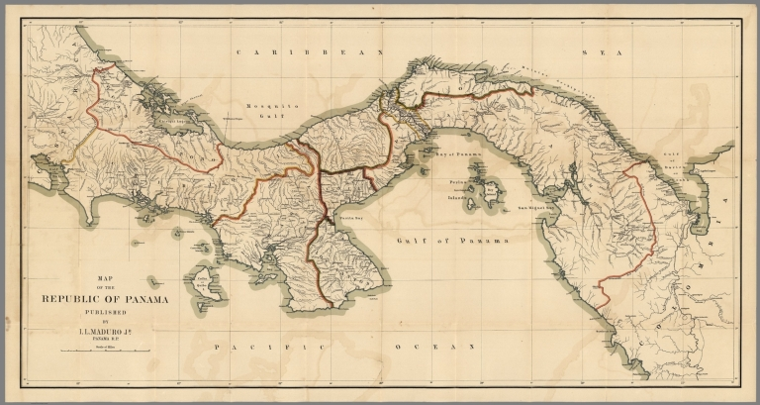
Panama
Source: Dave Rumsey Map Collection – Map Date: 1912
Notes:
Bio

Slide 15
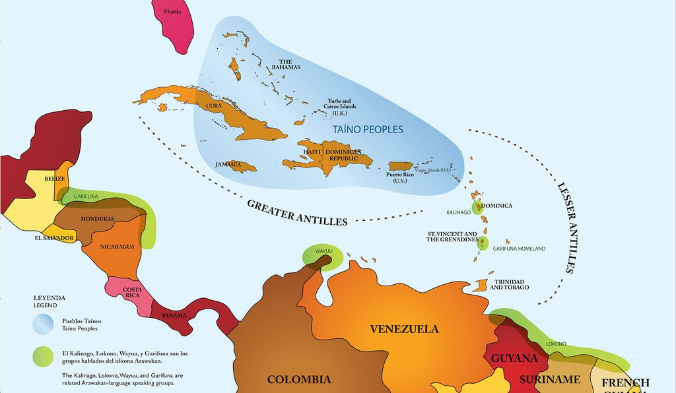
Indigenous Peoples Taíno (Aruaco/Arawak)
Representation of Eastern and Western Nahuatl dialects
Source: Smithsonian.com – Visit for article on Taíno people
Notes:
Bio

Slide 16
Historical Context
Primarily excerpts from BBC – 4 October 2017
with additional entries as relevant to Margarita Engle books
1492 - The navigator Christopher Columbus claims Cuba for Spain
1493 - First reference to Taíno people, as they were named by conquistadors
1511 - Spanish conquest begins under the leadership of Diego de Velazquez, who establishes Baracoa and other settlements.
1526 - Importing of slaves from Africa begins
Notes:
Bio

Slide 17
Historical Context
1812 – Slave rebellion repressed
1844 - Año del Cuero (Year of the Lash) - False rumors of slave rebellion resulting in arrest and execution of hundreds of people of all races, including slaves and poets
1847-74 - Chinese Indentured Workers in Cuba Contracts
1858 – US makes offer to buy Cuba; Spain refuses
1868-78 - Ten Years War of independence ends in a truce with Spain promising reforms and greater autonomy - promises that were mostly never met
1870-80 - Anti-Asian Riots throughout the US West (Los Angeles in 1871)
1880-86 – Gradual abolition of slavery throughout Cuba
Notes:
Bio

Slide 18
Historical Context
1895-98 – Poet Jose Marti leads a second war of independence; US declares war on Spain (Jose Marti dies in 1895 during the first battle)
1898 - US defeats Spain, which gives up all claims to Cuba and cedes it to the US
1902 - Cuba becomes independent with Tomas Estrada Palma as its president; however, the Platt Amendment keeps the island under US protection and gives the US the right to intervene in Cuban affairs.
1903-14 - Building of the Panama Canal
1906-09 - Estrada resigns and the US occupies Cuba following a rebellion led by Jose Miguel Gomez.
1909 - Jose Miguel Gomez becomes president following elections supervised by the US, but is soon tarred by corruption.
1912 - US forces return to Cuba to help put down black protests against discrimination.
1930s - Millo Castro Zaldarriaga plays drums in all-girl band Anacoana
Notes:
Bio

Slide 19
Historical Context
1934 - The US abandons its right to intervene in Cuba's internal affairs, revises Cuba's sugar quota and changes tariffs to favour Cuba.
1953 - Fidel Castro leads an unsuccessful revolt against the Batista regime.
1956 - Castro lands in eastern Cuba from Mexico and takes to the Sierra Maestra mountains where, aided by Ernesto "Che" Guevara, he wages a guerrilla war.
1958 - The US withdraws military aid to Batista.
1959 - Castro leads a 9,000-strong guerrilla army into Havana, forcing Batista to flee. Castro becomes prime minister, his brother, Raul, becomes his deputy and Guevara becomes third in command.
1960 - All US businesses in Cuba are nationalised without compensation.
1961 - Washington breaks off all diplomatic relations with Havana.
The US sponsors an abortive invasion by Cuban exiles at the Bay of Pigs; Castro proclaims Cuba a communist state and begins to ally it with the USSR.
Notes:
Bio

Slide 20
Americas Award Workshop with Margarita Engle A professional development workshop for Educators
February 27, 2018
4:30 – 7:30 p.m.
Stanford University
Notes:
Introductions
Molly
Elizabeth
Francisco Jimenez (full bio later)
Teachers

